Slide 1
Crestline Bank
Cloud Network DESIGN & Migration
Project: Infrastructure Modernization & Multi-Tier VPC Network Design
Presenter: Anasieze Ikenna

Slide 2
Project Background & Objective
Current State Architecture: Core banking running on a single on-premises server with zero redundancy, no network isolation, and unsafe direct internet exposure.
The Core Directive: No internal backend system or database should ever be directly reachable from the public internet.

Slide 3
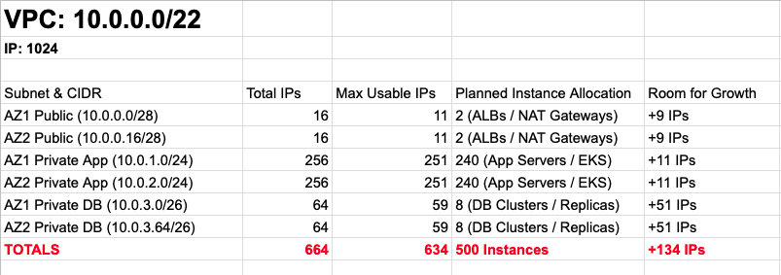
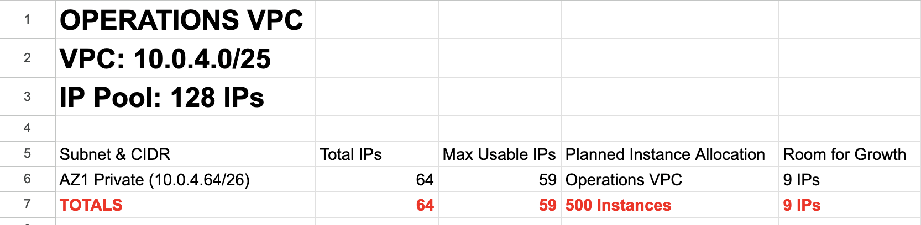
VPC Environment Scale & CIDR Strategy
Production Vpc

Slide 4
PRODUCTION VPC, Traffic Control & Gateway Architecture
Single Internet Gateway (IGW) for public routing and an active NAT Gateway deployed in the AZ 1A public tier to execute outgoing private app requests.
Route Table Segregation:
Public Route Table: 0.0.0.0/0 =====➔ Internet Gateway.
Private App Route Table: 0.0.0.0/0 =====➔ NAT Gateway (enables secure, outbound-only system updates).
Database Route Table: No default internet route. Completely isolated from the internet.

Slide 5
Layer 1 Defence: Stateful Security Groups
SG-Web-Tier: Accepts inbound 80/443 from anywhere (0.0.0.0/0), and Port 22 strictly restricted to the administrator IP address.
SG-App-Tier: Inbound restricted strictly to traffic originating from SG-Web-Tier on port 8080 and port 22. No direct external connection.
SG-DB-Tier: Inbound restricted strictly to traffic originating from SG-App-Tier on port 3306.
Stateful Execution: Outbound rules are tightly scoped to local boundaries, leveraging AWS stateful tracking to handle response without opening broad outbound ports.

Slide 6
Layer 2 Defence: Stateless Network ACLs
Stateless Network Protection: Unlike security groups, NACLs require explicit rules for both incoming and outgoing packet flows.
The Ephemeral Port 1024-65535: The network layer does not track active sessions, high-range client-side ports must remain explicitly open to allow return communication from servers.
Fail-Safe Layering: Strict catch-all DENY rules ensure that if an accidental rule is made at the security group layer, the NACL drops unauthorized traversal at the subnet boundary.

Slide 7
Operations VPC & Cross-VPC Peering
The Ops Domain: Operations VPC (10.0.4.0/25) hosting an internal, isolated server.
EC2 Instance Connect: Access our Operations instance through a secure browser based client attached endpoint in the Ops private subnet.
VPC Peering: Encrypted private connection running directly across AWS infrastructure—bypassing the public internet entirely.
Access Control: Route tables updated on both ends to forward cross-VPC traffic through the peering connection.
Least Privilege: Production SG-App-Tier explicitly allows SSH (Port 22) only if the origin request maps back to the exact Ops VPC CIDR block.

Slide 8
FULL VPC LAYOUT

Slide 9
Proof of Isolation Matrix
# | Test Sequence | Target | Expected Outcome | Security Validation
1 | External SSH | Web-Server-1 | SUCCESS | Public routing & IGW operations function correctly
2 | Internal SSH Hop | App-Server-1 | SUCCESS | App tier accepts traffic from Web tier via SG chaining
3 | App Outbound Web Request | google.com via curl | SUCCESS | Private App subnet correctly routes out through NAT Gateway
4 | Direct Public SSH Attack | App-Server-1 | FAIL / TIMEOUT | True private subnet protection; no public visibility
5 | Database Internet Test | google.com via curl | FAIL | Total internet isolation; absolute compliance achieved
6 | Ops Cross-VPC Admin | App-Server-1 via Bastion | SUCCESS | VPC Peering functionality verified
7 | Ops Database Attack | DB-Server-1 via Bastion | FAIL / TIMEOUT | DB denies access to non-app traffic tiers

Slide 10
Architecture Verification & Regulatory Readiness
Compliance Checklist Met: Strict internal tier isolation verified via layered Security Groups and Network ACLs.
Zero Leak DB Zone: Confirmed that core database storage holds zero paths to or from the internet.
Resilient Architecture: Multi-AZ deployment ensures zero single points of failure for Crestline Bank operations.
Ready for Live Demonstration & Questions.

Slide 11


